Slide 1



http://pingo.edu.vn/thiet-ke-website-bang-php-codeigniter/
PHP Frameworks
Object Oriented Programming
Web Applications in Hatch
Tuan Duong
http://pingo.edu.vn/tuan-duong/

Slide 2
Contents
Introduction
Object and Class
Inheritance
Encapsulation
Private/Protected/Public

Slide 3
Introduction
A programming concept that treats functions and data as objects.
A programming methodology based on objects, instead of functions and procedures.
“I explain that procedural program is built around the "verbs" of the system, the things you want the system to do, whereas object-oriented programming is build about the "nouns," the things in the system, and what they are capable of.”

Slide 4
Object and Class
CLASS
Class is a "template"/"blueprint" that is used to create objects
Usually represents a noun, such as person, place or thing.
class Animal
{
}

Slide 5
Object and Class
OBJECT
In real world object is a material thing that can be seen and touched.
In OOP, object is a self-contained entity that consist of both data and procedures.
An instance of a class
INSTANCE
A case or occurrence of anything
A single copy of an object, there might be one or several objects, but an instance is a specific copy, to which you can have a reference
$instance = new Animal();
$dog = new Animal()

Slide 6

Inheritance

Slide 7
Inheritance
Biology - the genetic characters transmitted from parents to offspring
OOP - provides reusability of codes. We can add additional codes to an existing class without modifying it.
Can be defined as the process of one object acquires the properties of another by making subclasses (parent-child relationship)

Slide 8
Inheritance
<?php class SmartPhone { // Some methods and properties } class AndroidSmartPhone { // Some methods and properties }

Slide 9

Class Properties and Methods
Height
Weight
Pass
Dribble
Shoot
Rebound
Block

Slide 10
Properties
Also know as data members and is used to hold data of a class.
The data that it holds are specific to the nature of the class in which it has been defined.
class SmartPhone { public $name; public $generation; public $width; public $height; public $weight; }

Slide 11
Methods
<?php class Animal { public $name; public $height; public $weight; public function eat() { } public function sleep() { } }

Slide 12
Encapsulation
Facilitates the bundling of data with the methods (or other functions) operating on that data.
Restricting access to some of the object’s components.
Used to hide the values or state of a structured data object inside a class, preventing unauthorized parties' direct access to them.

Slide 13
Encapsulation
Access modifiers/Visibility
private
property and method can be accessed only inside the class itself and can't be accessed anywhere else
protected
property and method can be accessed only inside the class itself and inside child classes.
public
allows the property/method to be accessed from anywhere of code

Slide 14
Private
<?php class Love { private $heartbeatPerSecond = 100; public function getHeartBeatPerSecond() { return $this->heartbeatPerSecond; } } class Valentines extends Love { public function getHeartBeatPerSecWhenNear() { return $this->heartbeatPerSecond * 2; // Will produce an error } } $love = new Love(); echo $love->getHeartBeatPerSecond(); // Will echo 100 echo $love->heartbeatPerSecond; // Will produce an error

Slide 15
Protected
<?php class Love { protected $heartbeatPerSecond = 100; public function getHeartBeatPerSecond() { return $this->heartbeatPerSecond; } } class Valentines extends Love { public function getHeartBeatPerSecWhenNear() { return $this->heartbeatPerSecond * 2; // Will return 200 } } $love = new Love(); echo $love->getHeartBeatPerSecond(); // Will echo 100 echo $love->heartbeatPerSecond; // Will produce an error

Slide 16
Public
<?php class Love { public $heartbeatPerSecond = 100; public function getHeartBeatPerSecond() { return $this->heartbeatPerSecond; } } class Valentines extends Love { public function getHeartBeatPerSecWhenNear() { return $this->heartbeatPerSecond * 2; // Will return 200 } } $love = new Love(); echo $love->getHeartBeatPerSecond(); // Will echo 100 echo $love->heartbeatPerSecond; // Will echo 100

Slide 17
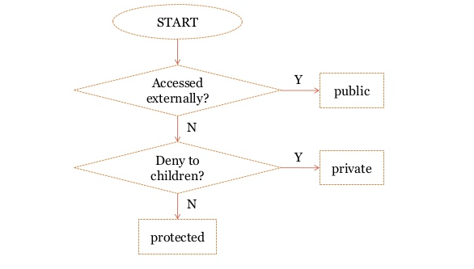
Choosing the Right Visibility

Slide 18
PHP Basics - Statements

